Slide 1

Industry Internship Report On Smart City ecosystem using IoT Submitted to: Amity University Uttar Pradesh, Noida
In partial fulfilment of the requirements for the awards of the degree
B.Tech (Information Technology)
By
Rajan Goel (A12405316018)
Under the guidance of
Dr. Saru Dhir
Department of Information Technology
Amity School of Engineering and Technology
Amity University Uttar Pradesh, Noida

Slide 2
TOPICS
What’s Internet of Things (IoT)
What’s Smart City Ecosystem
How Smart city is different from Normal Cities
IoT Integration and Commissioning
Smart Cities map
Integrated Command and Control Center
Operator Screen view
Connected Field Force through Mobile App

Slide 3
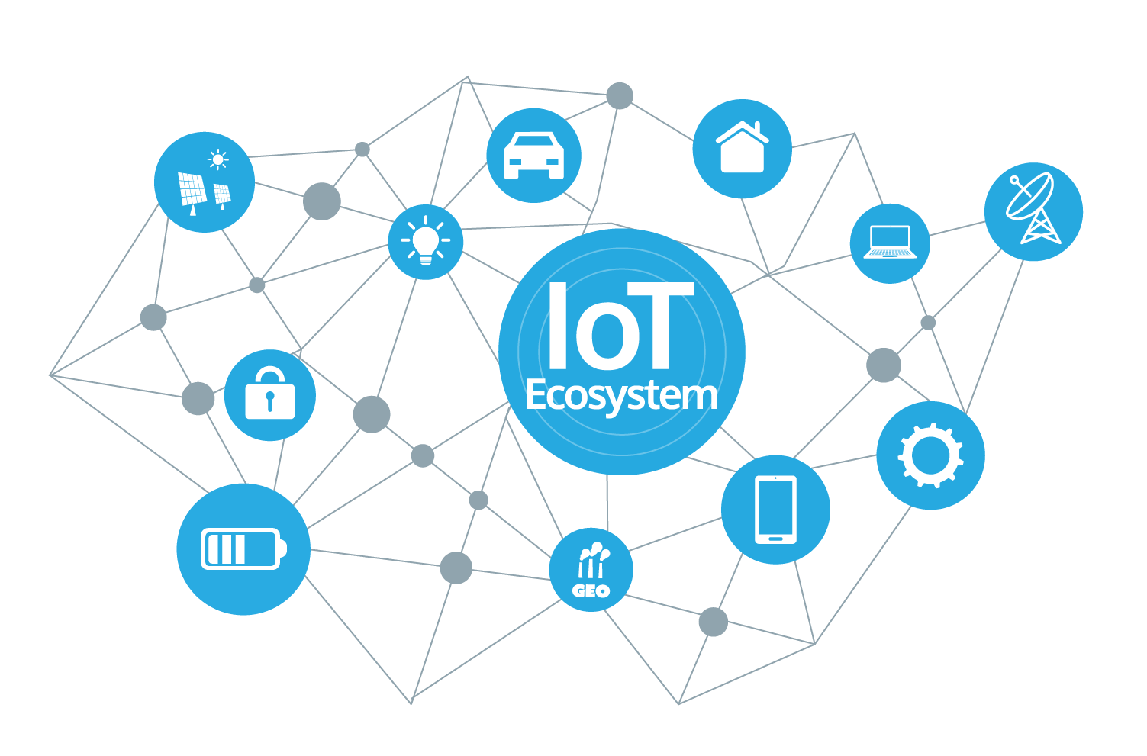
What’s Internet of Things (IoT)
“The Internet of Things (IoT) is a system of interrelated computing devices, mechanical and digital machines, objects, animals or people that are provided with unique identifiers and the ability to transfer data over a network without requiring human-to-human or human-to-computer interaction.”
When something (like Street Lights, Waste Bin) is connected to the internet, that means it (device) can send information or receive information or even both. This ability of sending and receiving the information from something (devices like Smart electric meter, parking sensors) makes the thing smarter, meaningful, data oriented and better for human life.
IoT Ecosystem (Platform)
Internet connectivity (LoRa, VPN, Satellite, GSM, Wi-Fi, etc.)
Devices (CAR, Light, Dustbin, Meters, Parking sensors)
Mobile Application
Security System
Consumers (Users)

Slide 4
What’s is Smart City Ecosystem
A smart city is an urban areas that uses different types of electronic Internet of things (IoT) sensors like
Ultrasonic sensor, Light dependent resistor (LDR) to collect data
Use intelligence from that data to manage assets (smart lights, Waste bin, Smart meters), resources and services efficiently.
This includes data collected from citizens, devices, and assets that is processed and analysed to monitor and manage
Traffic and Transportation systems, power plants, utilities, water supply networks, waste management, crime detection, information systems, schools, libraries, hospitals, and other community services.
The smart city concept integrates Information and Communication technology (ICT), and various physical devices (sensors, actuators) connected to the IoT network to optimize the efficiency of city operations and services and connect to citizens.
Smart city technology allows city officials to interact directly with both community and city infrastructure and to monitor what is happening in the city and how the city is evolving.
ICT is used to enhance quality, performance and interactivity of urban services, to reduce costs and resource consumption.

Slide 5
How Smart City is different from Normal cities
Smart City can be considered as an upgrade to an existing city which makes the life of a citizen better, smarter, and meaningful. The primary focus points of smart cities typically are to provide efficient use of existing infrastructure and to lay a roadmap for increased visibility or transparency for the average citizen in the city governance.
Providing public displays or portals where information is provided continuously to enable decision making by citizens.
Having smart governance structures in place to track citizen complaints and provide redressal.
Engage citizens to provide better utilization of traffic infrastructure, transport services and energy/ waste management
Service Delivered | Normal City | Smart City | Difference
Parking | Manual Parking | Self Driven | Sensor Based Mobile Application Time and Money Saving
Waste Management | Waste Bin | Smart Waste Bin | Sensor Based Life Improvement (wastage picked before it cross the limit) Time and Money Saving
Smart Lighting | Normal streetlights, Bulbs, etc. | Smart Lights, LED(s) | Sensor Based Saving Electricity by auto-managed Lifespan, Better Quality, visibility
Environment | Weather Forecast (One Source) | Senor Based | Environment Data area by area More Kind of Data (PMI, Pollution, Water level, visibility) Improve Life
Electric Meters | Manual Analog Meter | Digital Sensor Meter | Sensor Based Minimum Human Intervention Pay by Use

Slide 6
IoT Integration and Commissioning
Cloud Platform | IoT & ICCC Application | Devices | Sensors | Network
Amazon Web Services | Amazon Web Services IoT Platform | Smart Roads Smart lights Waste management Smart parking management Smart Traffic signals | Light Dependent Resistor(LDR) Ultrasonic Sensor Proximity Sensor Induction Loops | Wi Fi Local Area Network GSM / CDMA VPN Satellite LoRA Network LPWANs
Google Cloud Platform | Google Cloud Platform | Smart Building Smart surveillance Smart Parking Water & Electric meter | Charged coupled device(CCD) Proximity Sensor Probe Sensor
Microsoft Azure | Microsoft Azure IoT Hub | Smart Automobiles Smart parking sensors Smart GPS (Vehicle tracking) Smart Security | Proximity Sensor GPS Passive Infra-Red(PIR)
IBM Bluemix | IBM Watson IoT Platform | Smart Environment Water Tanks Air pollution | Hydrostatic Pressure level Optical particle counter

Slide 7
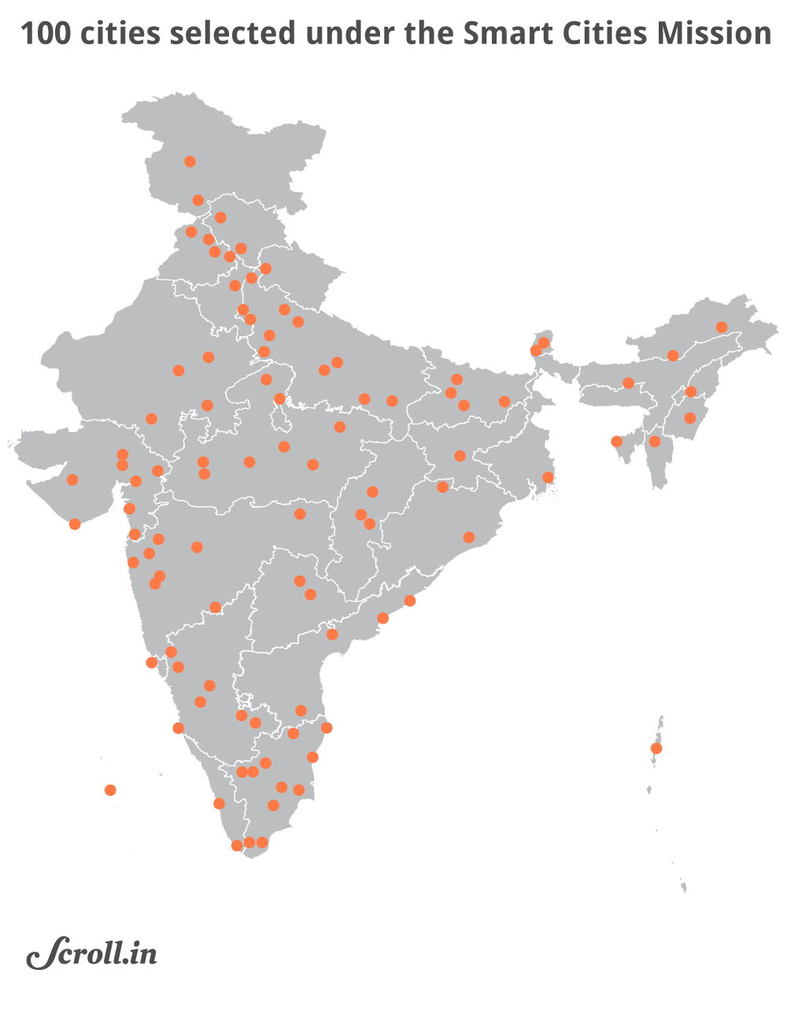
Smart Cities Map
India Central Government has taken the initiative to convert normal urban cities to Smart Cities. This project was launched by India Honorable Prime Minster Shri Narendra Modi in Year 2015.
Smart City Project is divided in 5 phases
1st Round | Selection of 20 Smart Cities.
2nd Round | Selection of 13 Smart Cities.
3rd Round | Selection of 27 Smart Cities.
4th Round | Selection of 30 Smart Cities.
5th Round | Selection of 9 Smart Cities.
Smart Cites :
Bhubaneshwar Smart City
Pune Smart City
Bhopal Smart City
Ranchi Smart City
Varanasi Smart City

Slide 8

Integrated Command and Control Center
Integrated Command & Control Center
City Command interfaces Solution Wise
Smart Surveillance
ITMS
Smart Waste Manag.
Disaster Management
Smart Env Manag
Any Future Integration
City Applications
Smart City

Slide 9








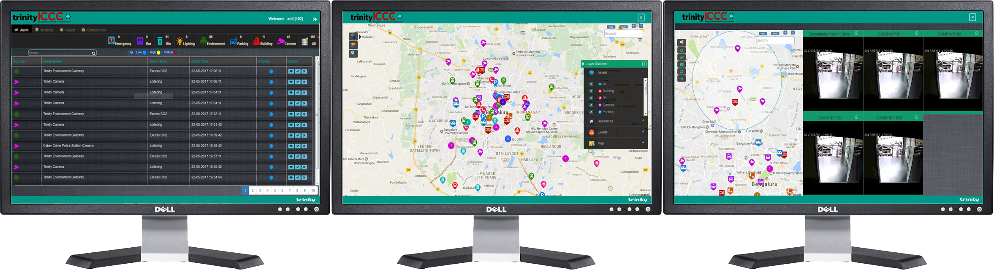
Operator Screen View
Smart Pole/
Street Light
Water
Parking
Electricity
Waste
Environment
Building
Camera
Alert Management
Map based Visualization
Video Console
Easy to Use Fully Integrated Multi-Monitor Web Console
Back

Slide 10
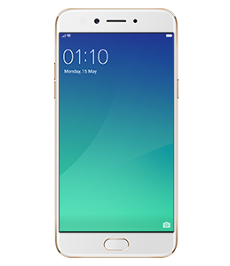
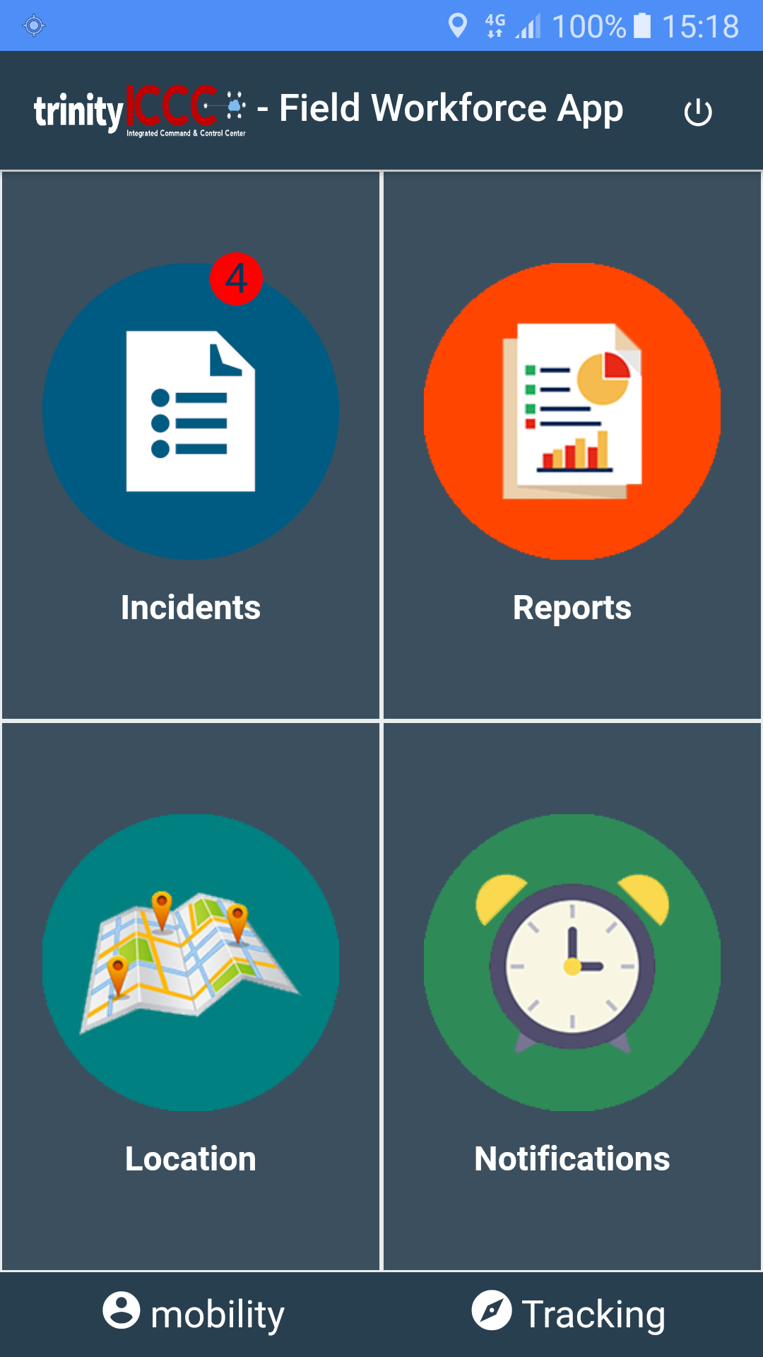
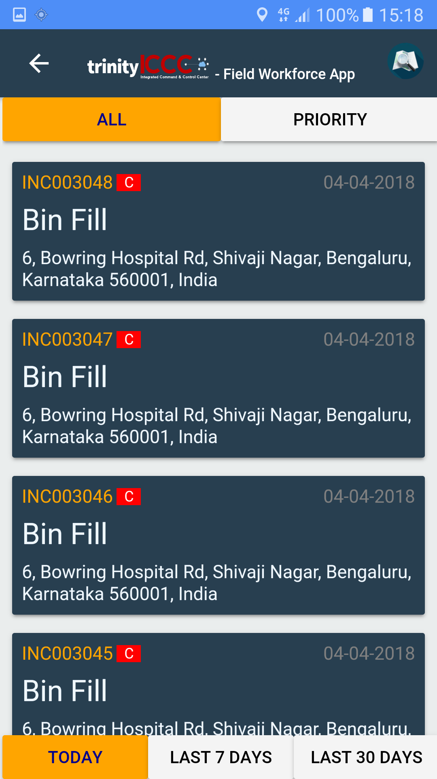
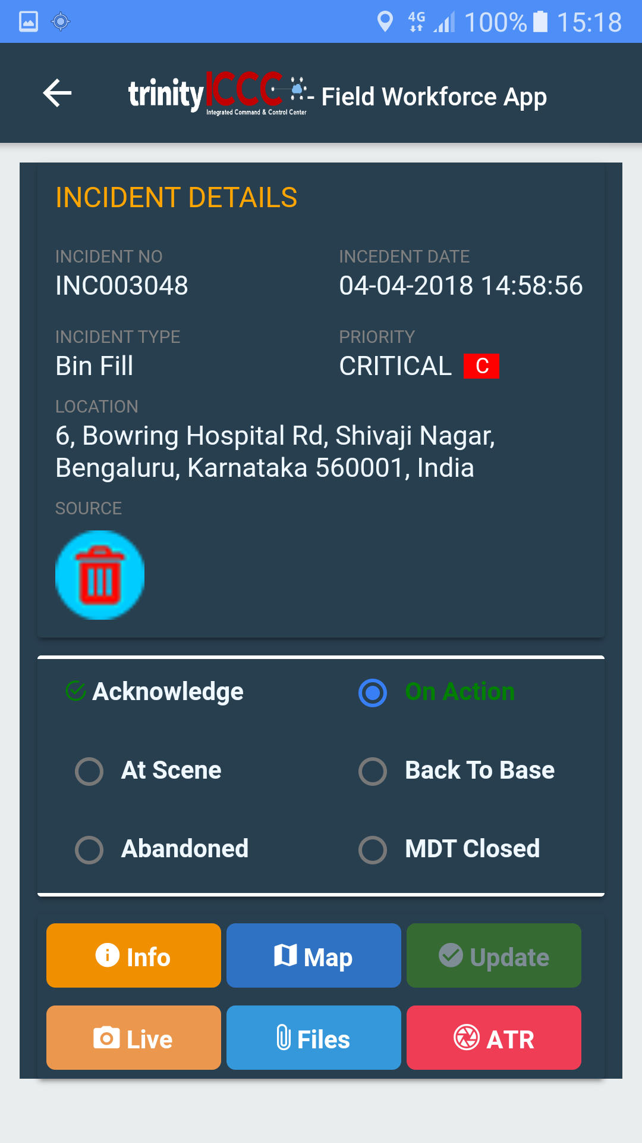
Connected Field Force through Mobile App
Mobile App support for Smart Phone
Tablet/Rugged Mobile Data Terminal
Provide Full Visibility to Field Responder
Map based Navigation support
Live Video of Camera and Sensor Data insight
Update Control Room on Status
Action Taken Report including Audio, Video
Back

Slide 11
Q&A
Thank You
Rajan goel

